Slide 1


Privacy and Ethics
in Data Science
http://www.datascience4all.org
Introduction to Computational Thinking and Data Science
Yolanda Gil
University of Southern California
gil@isi.edu
CC-BY
Attribution
ACI-1355475
Last Updated:
September 2016

Slide 2
Intended Audience
Designed for students with no programming background who want to have literacy in data and computing to better approach data science projects
Computational thinking: a new way to approach problems through computing
Abstraction, decomposition, modularity,…
Data science: a cross-disciplinary approach to solving data-rich problems
Machine learning, large-scale computing, semantic metadata, workflows,…

Slide 3

These materials are released under a CC-BY License
https://creativecommons.org/licenses/by/2.0/
You are free to:
Share — copy and redistribute the material in any medium or format
Adapt — remix, transform, and build upon the material
for any purpose, even commercially.
The licensor cannot revoke these freedoms as long as you follow the license terms.
Under the following terms:
Attribution — You must give appropriate credit, provide a link to the license,
and indicate if changes were made. You may do so in any reasonable manner,
but not in any way that suggests the licensor endorses you or your use.
Artwork taken from other sources is acknowledged where it appears.
Artwork that is not acknowledged is by the author.
Please credit as: Gil, Yolanda (Ed.) Introduction to Computational Thinking and Data Science. Available from http://www.datascience4all.org
If you use an individual slide, please place the following at the bottom: “Credit: http://www.datascience4all.org/”
As editors of these materials, we welcome your feedback and contributions.

Slide 4
Acknowledgments
ACI-1355475
These course training materials were originally developed and edited by Yolanda Gil (USC) with support from the National Science Foundation with award ACI-1355475
They are made available as part of http://www.datascience4all.org
The course materials benefitted from feedback from many students at USC and student interns, particularly Taylor Alarcon (Brown University), Alyssa Deng (Carnegie Mellon University), and Kate Musen (Swarthmore College)
We welcome new contributions and suggestions

Slide 5
Privacy
Privacy
Fair Information Practices
Managing sensitive data
Anonymizing sensitive data
Re-identifying datasets
Reproducibility
Societal value of data and data science

Slide 6
Privacy

Slide 7
The Rise of Privacy Concerns
Science:
benefits of sharing clinical patient records
patients shall control access to their records
patients found to be altruistic:
willing to grant access for purpose of advancing science
Government:
government and commercial use of data mining raises concerns about appropriate use of private citizen information,
e.g., data collected for the purpose of airline passenger screening should not be used for the enforcement of other criminal laws
Open Web:
many users are happy to share private details on social webs
but would be rightfully upset was this data used for other purposes
content is shared between networks
not very transparent to the user
users need to be reassured about appropriate use of their data

Slide 8
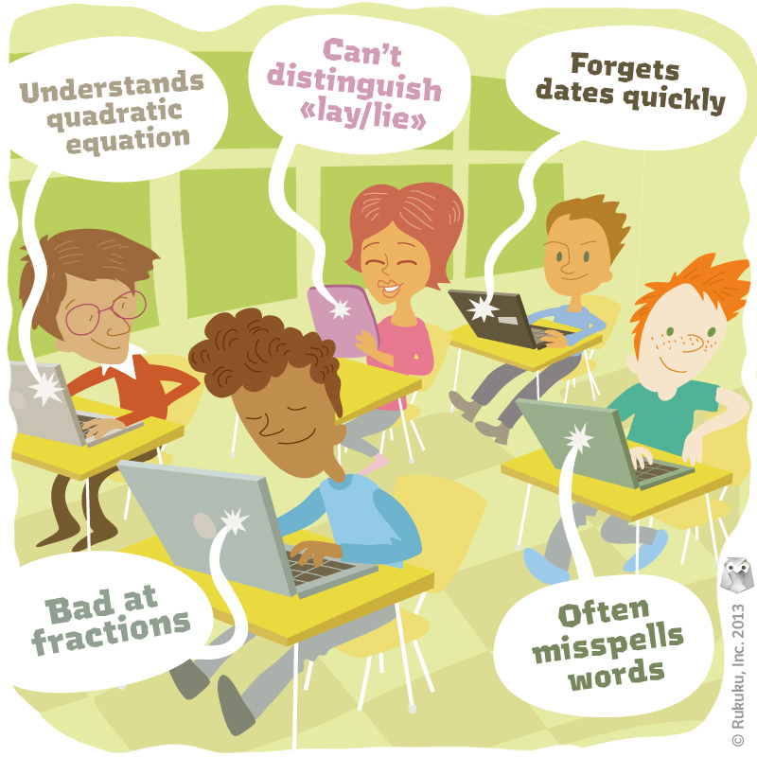

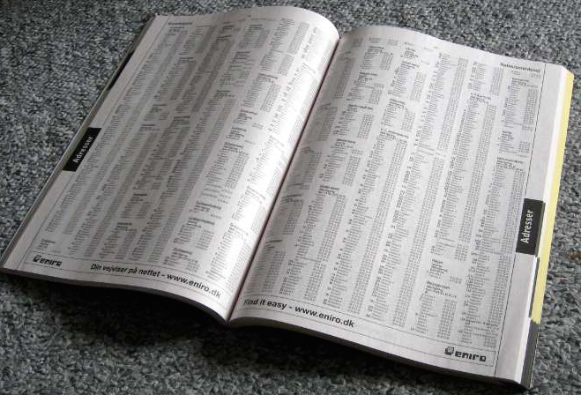
Private and Sensitive Data
http://www.rukuku.com/blog/wp-content/uploads/student-data-and-personalization.jpg
http://www.crimeoff24.com/?p=4869
https://en.wikipedia.org/?title=Telephone_directory#/media/File:Telefonbog_ubt-1.JPG

Slide 9
Sensitive Data and Privacy
Sensitive Data
Privacy
Data about individuals and organizations that should not be freely disseminated and publicized
Health
Education
Finance
Demographic
Criminal
Location
Behavior
Desire to limit the dissemination of sensitive data
Lots of technology, but:
Unclear requirements
Unclear behaviors

Slide 10
Sensitive Data
identifying values
sensitive attribute

Slide 11
OECD’s Eight Principles of Fair Information Practices [OECD 1980]
A framework for privacy protection
Protect use
Collection for a purpose
Use only for authorized purpose
Accountability throughout these principles

Slide 12
Define questions
Pre-process data
Analyze data
Present results
Collect/find data
Store data
Extract data
Publish data

Slide 13
Define questions
Pre-process data
Analyze data
Present results
Collect/find data
Store data
Extract data
Publish data
Institutional Review Board
Provisions for collection, storage, processing, and dissemination of sensitive data

Slide 14
Define questions
Pre-process data
Analyze data
Present results
Collect/find data
Store data
Extract data
Publish data
Consent
State purpose/use
Decent quality
Allow corrections

Slide 15
Define questions
Pre-process data
Analyze data
Present results
Collect/find data
Store data
Extract data
Publish data
Physical safety
Personnel training
Access control
Encryption

Slide 16
Define questions
Pre-process data
Analyze data
Present results
Collect/find data
Store data
Extract data
Publish data
Limit data use based on the purpose expressed in the original consent
Secure data transmission
Anonymization

Slide 17
Anonymization Techniques
Replace identifiers with randomly-generated identifiers
Eg: “Jane Krakowski” -> “Patient6479”
Abstraction: Replace values by ranges
Eg: Check-in date: 3/1/16 -> Check-in date: Spring 2016
Eg: Replace zip code by state
Cluster data points and replace individuals by their cluster centroid
Eg Ages: 21, 25, 28, 27, 18 -> 5 individuals with nominal age of 24
Remove values
Eg: Omit birth date

Slide 18
Problems with Anonymization Techniques
Limited use for research
Too coarse-grained
Re-identification
Re-identification is often trivial
E.g., anomymized list of students admitted showing undergraduate university and average GPA
Re-identification is possible with high certainty in many cases
By linking the anonymized dataset with other public data that is not anonymized

Slide 19
Examples of Re-Identification through Linking Data: (I) Medical Records
87% of the population can be uniquely identified based solely on birthdate, sex, and zip code
Most datasets even if anonymized contain this information
http://dataprivacylab.org/dataprivacy/projects/kanonymity/kanonymity.html
Notes:
William Weld was governor of Massachusetts at that time
and his medical records were in the GIC data. Governor Weld lived in
Cambridge Massachusetts. According to the Cambridge Voter list, six people
had his particular birth date; only three of them were men; and, he was the
only one in his 5-digit ZIP code

Slide 20
Examples of Re-Identification through Linking Data: (II) Opinions
Published anonymized data about reviews
Public dataset contained reviews that were not anonymized and could be mapped based on the date
Review date
Anonymized Netflix data
Named IMDB data
Notes:
William Weld was governor of Massachusetts at that time
and his medical records were in the GIC data. Governor Weld lived in
Cambridge Massachusetts. According to the Cambridge Voter list, six people
had his particular birth date; only three of them were men; and, he was the
only one in his 5-digit ZIP code

Slide 21
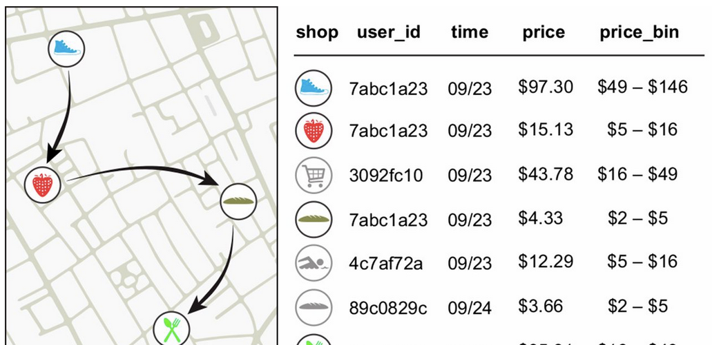
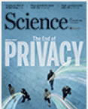
Examples of Re-Identification through Linking Data: (III) Behavior Patterns
Four spatiotemporal points are enough to uniquely re-identify 90% of individuals
Even data sets that provide coarse information for all dimensions provide little anonymity
http://science.sciencemag.org/content/347/6221/536.full

Slide 22
Addressing the Problems of Simple Anonymization Techniques
Provide guarantees that re-identification will not be possible within some bounds
Eg: can only map a given individual to a set of 50 individuals
k-anonymization
l-diversity
t-closeness
Differential privacy

Slide 23
Addressing Anomymization Problems: k-Anonymity
A dataset has k-anonymity if at least k individuals share the same identifying values
k=2

Slide 24
Addressing Anomymization Problems: l-Diversity
A dataset has l-diversity if the individuals that share the same identifying values have at least l distinct values for the sensitive attribute
l=1

Slide 25
Addressing Anomymization Problems: t-Closeness
A dataset has t-closeness if the individuals that share the same identifying values have values for the sensitive attribute that are within a threshold t of diversity
Threshold is mathematically defined for the data

Slide 26
Differential Privacy
Only method that provides mathematical guarantees of anonymity
Main problem addressed: Taking an individual I off a dataset reveals their sensitive attribute information
Eg: retrieving aggregate data before removal, then retrieving aggregate data after removal, and then comparing the difference will give us the sensitive attribute of I
Main idea: Differential privacy adds “noise” to the retrieval process so that such comparisons do not give us the actual sensitive attribute information
“noise” is mathematically defined for the data

Slide 27
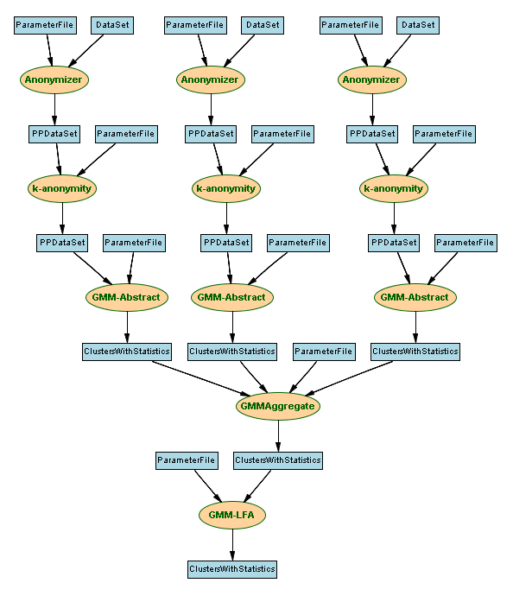
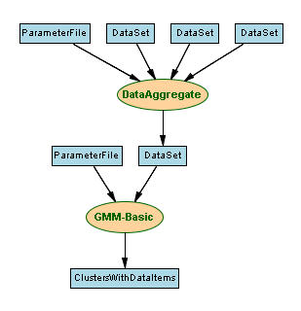
Privacy-Aware Workflows
P1: No personal ID information can
leave the data source
P2: Sensitive data must be k-anonymized
Distributed workflow compliant with policies
Loc1 .. Loc n
Centralized workflow not compliant with policies
Anonymization
Loc1
Loc2
Aggregation
Abstraction
Loc3
Loc2
Analysis
Aggregation
Loc3
Analysis

Slide 28
Summary: Threats to Privacy
Privacy requirements are not well articulated
People want benefits in exchange for data
Unclear that we are able to limit collection and publication
Unique behavior of people (we don’t read legal contracts)
Human error, not without consequences
Mounds of sensitive data about individuals is readily available in the open web
Open web already contains sensitive information that should not be available and violates privacy acts
Lots of commercial data with personal information is for sale
Limited understanding of anonymization and other privacy technologies
Linking to public datasets leads to re-identify individuals

Slide 29
Reproducibility

Slide 30
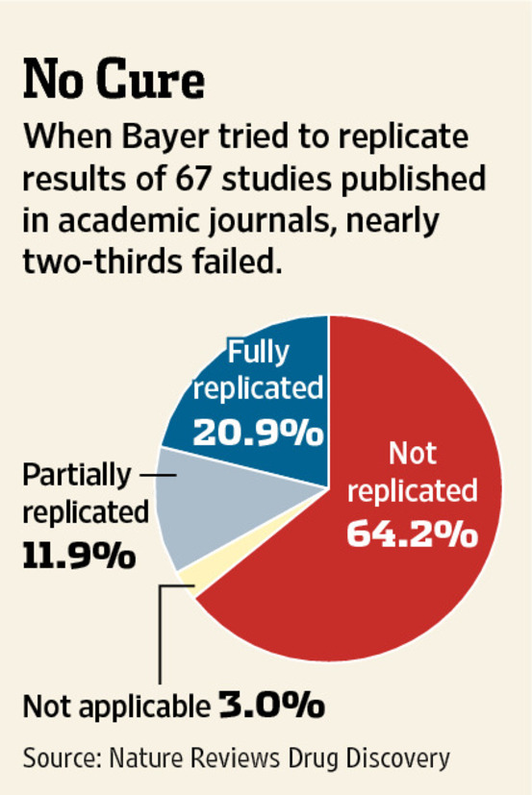
http://www.wsj.com/articles/SB10001424052970203764804577059841672541590

Slide 31
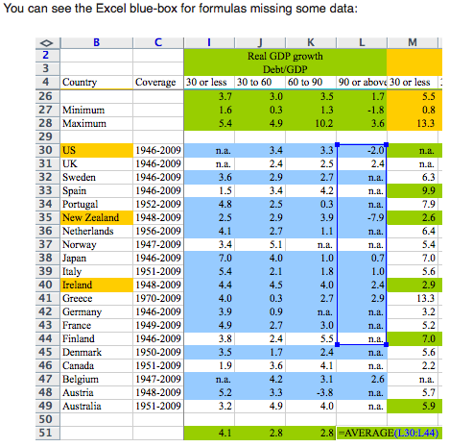

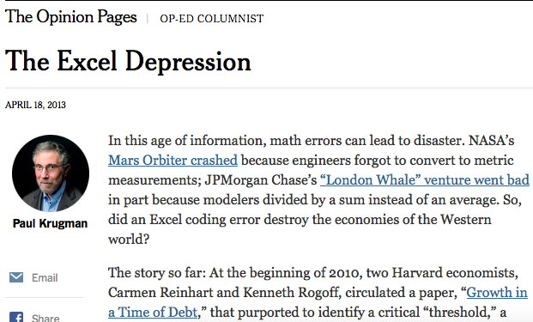
http://www.nytimes.com/2013/04/19/opinion/krugman-the-excel-depression.html
http://www.nextnewdeal.net/rortybomb/researchers-finally-replicated-reinhart-rogoff-and-there-are-serious-problems

Slide 32
Societal Value of Data and Data Science

Slide 33
Granting Access to Private Records: Health Information
Anonymized information is often not useful for research
Too coarse grained
Private information has great value
Tradeoff with quality of treatment
Incentivized through first access to new treatments
Altruism
Giving up privacy for pre-specified uses
Eg: for specific medical study, not for insurance purposes, not for employers, not for social studies

Slide 34
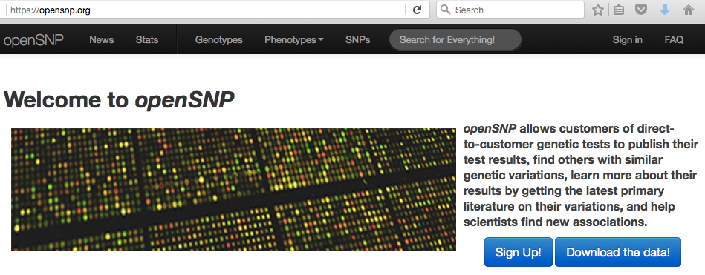
There is zero privacy anyway, get over it
Although you can upload your data using a pseudonym, there is no way to anonymously submit data. Statistically speaking it is really unlikely that your medical and genetic information matches that of someone else. By uploading you do not only disclose information about yourself, but also about your next kinship (parents and siblings), that shares half of a genome with you. Before uploading any genetic data you should make sure that those people approve of you doing so. This is especially important if you have monozygotic twin, who shares all of your genome!

Slide 35
Privacy
Privacy
Fair Information Practices
Managing sensitive data
Anonymizing sensitive data
Re-identifying datasets
Reproducibility
Societal value of data and data science

